Slide 1

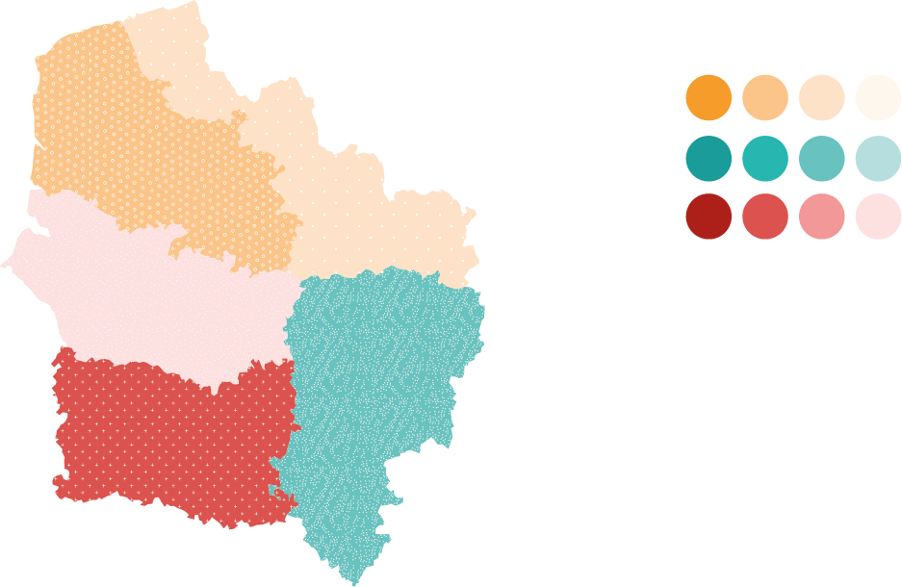


2026
Regional mapping
Coastline of Nord and Pas-de-Calais

Slide 2

Recontextualisation and Methodology
1

Slide 3
SUBLIME SDGs
1
PROJECT OBJECTIVES
SUBLIME SDGs is a project running from November 2025 to February 2028 along the coast of Nord and Pas-de-Calais. Its aim is to empower citizens, particularly young people and women, to create local initiatives promoting:
Sustainable development and the green transition
Gender equality and gender minorities
In the service of a shared narrative of international solidarity.
OUR ROLE
To present advocacy stemming from citizens’ initiatives to elected representatives and local authorities, turning them into drivers of international cooperation between regions.
To improve local authorities’, associations’ and citizens’ groups’ understanding of the challenges of ecological transitions, as well as gender equality and equality for gender minorities.
To strengthen citizen participation in international cooperation projects working on sustainable development, covering the ecological transition and gender equality

Slide 4
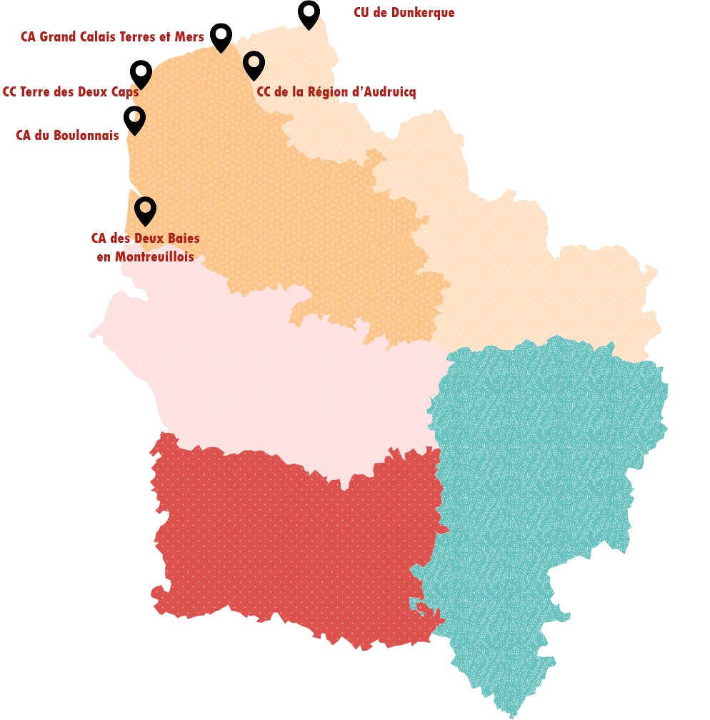
1
METHODOLOGY
STUDY AREA
6 inter-municipal bodies on the coast of Nord and Pas-de-Calais
DIVERSE AND COMPLEMENTARY SOURCES OF INFORMATION
13 semi-structured interviews
15 responses to the online questionnaire distributed within our network
Review of local planning documents
Analysis of news on social media

Slide 5
1
DELIVERABLE
LOCAL MAPPING OF THE SDGs
Study of stakeholders, challenges and opportunities across various issues, through the lens of the Sustainable Development Goals (SDGs):
Global citizenship and development education on the coast of Nord and Pas-de-Calais
Achieving gender equality and equality for gender minorities at local level
Decent work for migrant workers and the fight against all forms of inequality: mapping vulnerable groups
Building sustainable communities and cities
Environmental responsibility and local climate action
Multi-level governance and multi-stakeholder partnerships for sustainable development
OTHER STRATEGIC ELEMENTS
Results of interviews and questionnaire responses
Inspiring coastal practices
Communication practices
Analysis of local planning documents
Mapping of ‘change agents’

Slide 6
Study results by Sustainable Development Goal (SDG)
2

Slide 7
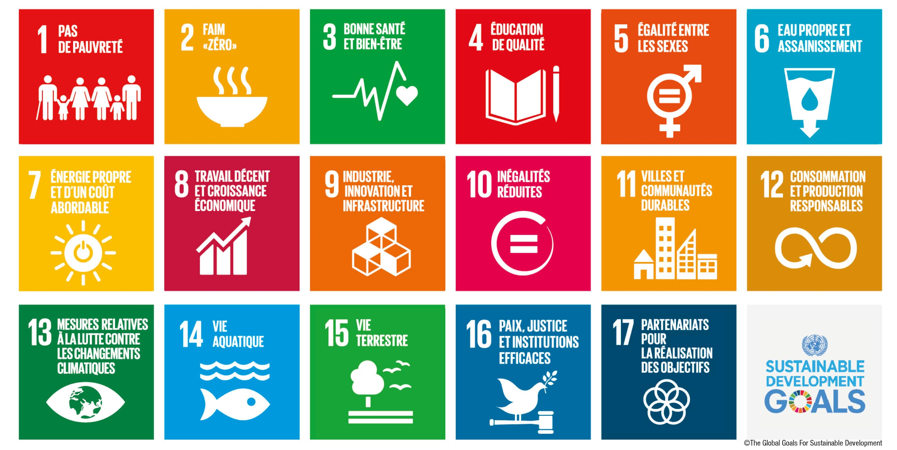
2
SDG 4: QUALITY EDUCATION
PROGRESS TOWARDS THE SDGs IN THE STUDY AREA
Significant progress has been made in integrating sustainable development into educational curricula, particularly with regard to coastal issues: for example, the French Biodiversity Agency’s network of marine areas and the ‘Weeks of the Sea’.
A few initiatives combining global citizenship education and sustainable development, such as the projects led by the Artois Picardie Water Agency, notably the Youth Parliament for Water.
The development of initiatives remains dependent on the motivation of teaching staff, who lack the time and resources specifically dedicated to setting up innovative projects.
AREAS FOR FURTHER DEVELOPMENT
Monitor the project for a Hauts-de-France Maritime Academy, bringing together school initiatives and practices relating to the coast and the sea, with the possibility of awarding accreditation to schools.
Encourage links between formal and non-formal education, particularly regarding global citizenship education, which could incorporate local events related to heritage and sustainable development more extensively.

Slide 8
SDG 5: GENDER EQUALITY
2
SDG PROGRESS IN THE STUDY AREA
Significant progress has been made in combating discrimination in schools: cyberbullying, understanding ‘dys’ disorders, tackling prejudice, etc. These measures appear to be driven at national level, with little specific action taken at local level.
No study on gender inequalities has been carried out across the study area. Mandatory regulatory powers are primarily at national level. Consequently, gender equality issues remain focused on combating violence and supporting women entrepreneurs, and do not necessarily address the systemic dimension of patriarchy.
A network of centres combating violence against women has been developed, but it remains insufficient given the scale of the problem (particularly regarding the issue of housing).
AREAS FOR FURTHER DEVELOPMENT
Monitor the impact of incorporating Education for Emotional, Relational and Sexual Well-being (EVARS) into the school curriculum.
Promote a region-specific assessment of gender-based violence and violence against sexual minorities.
Support the development of partnership-based approaches between activist groups, associations and local authorities.

Slide 9
2
SDG 8: DECENT WORK AND ECONOMIC GROWTH
SDG 10: REDUCED INEQUALITIES
PROGRESS TOWARDS THE SDGs IN THE STUDY AREA
AREAS FOR FURTHER DEVELOPMENT
Gradual deterioration in the circumstances of the most vulnerable people due to inflation
Increase in the number of migrants whose status is becoming irregular due to recent anti-immigration laws and circulars.
Rapid deterioration in young people’s mental health, causing concern for organisations providing integration and support for employment and training.
Deterioration in the living conditions of people migrating illegally to the United Kingdom: militarisation of the border, policies to dismantle camps and crackdowns on humanitarian aid organisations.
Strengthen policies to combat prejudice and discrimination based on presumed origin.
Create spaces for information, discussion and action on migration issues and human dignity within the region.
Strengthen psychosocial support services for young people, in particular by creating spaces for collective exchange.

Slide 10
SDG 11: SUSTAINABLE CITIES AND COMMUNITIES
2
PROGRESS TOWARDS THE SDGs IN THE STUDY AREA
Local planning supports soil protection, particularly in line with the Act of 20 July 2023 aiming for a net zero rate of land sealing by 2050. However, the pressures this places on the various activities within the region deserve to be addressed more directly and collectively.
Environmental health is a well-developed area in the region, particularly in relation to the impact of air pollutants on health.
There are numerous measures to protect heritage and natural areas, but the links between these various activities could be strengthened, as is the case in the Dunkirk area thanks to the Halle aux Sucres.
AREAS FOR FURTHER DEVELOPMENT
Strengthen the role of citizens in the design of urban spaces and public policies.
Support sustainable development measures that improve environmental and human health.
Make decarbonisation solutions accessible to all, and in particular raise awareness among local authorities of the importance of accessible public spaces in inclusion initiatives.

Slide 11
2
SDGs 12 AND 13: ENVIRONMENTAL RESPONSIBILITY AND LOCAL CLIMATE ACTION
PROGRESS TOWARDS THE SDGs IN THE STUDY AREA
The issue of the region’s climate resilience features prominently in discussions in the Nord and Pas-de-Calais coastal areas, largely due to numerous vulnerabilities: risks of submersion, flooding, coastal erosion, etc.
Local industries and businesses are committed to decarbonisation projects, but other concerns appear to take priority, particularly recruitment difficulties and issues of international competitiveness.
Many organisations are working to raise residents’ awareness of sustainable lifestyles, but in terms of material consumption, the volume of waste produced remains very high.
AREAS FOR FURTHER DEVELOPMENT
Support sustainable tourism models, grounded in the protection of nature and the living conditions of residents at both local and global levels.
Enable everyone to better understand the links between consumption patterns and their impacts, at both local and global levels.

Slide 12
SDG 17: PARTNERSHIPS FOR THE ACHIEVEMENT OF THE GOALS
2
PROGRESS TOWARDS THE SDGs IN THE STUDY AREA
The international connections associated with port activities and the shared borders with Belgium and the United Kingdom are conducive to the development of partnerships, although these depend on the political will of elected representatives.
School partnerships are very common, due to the Franco-German and Franco-Polish ties developed after the Second World War. These can serve as a lever for the development of broader solidarity policies.
The multiplicity of levels of governance complicates the coordination of local policies. The development of cross-cutting plans such as Local Health Contracts and Territorial Food Projects presents opportunities for stakeholders from various sectors to work together.
AREAS FOR FURTHER DEVELOPMENT
Promote regional dialogue through cross-sectoral projects.
Promote participation in public debates and give greater prominence to dialogue in the design of public policies
Highlight existing multi-stakeholder collaboration initiatives, particularly those promoting sustainable development and the fight against inequality.

Slide 13
Inspiring practices
3

Slide 14
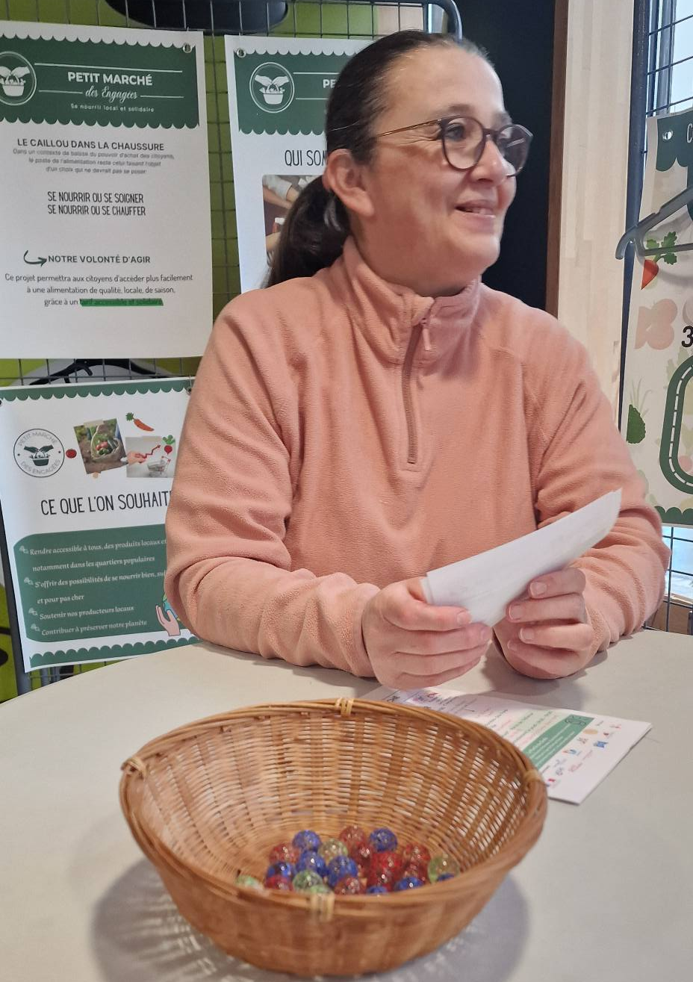
3
THE SMALL MARKET
OF COMMITTED WOMEN
Banc Vert, de l’Alliance, Saint-Nicolas-Pasteur and Petite Synthe neighbourhoods (Dunkirk).
DESCRIPTION OF THE INITIATIVE
Organic market selling fruit, vegetables, eggs, pulses and minimally processed products.
Three price options chosen by customers using coloured tokens (no proof of purchase or stigma).
MULTI-PARTNER GOVERNANCE
A project led by a collective of residents from the City’s Priority Neighbourhood (QPV), who are not only the ‘driving force’ but also manage the political aspects of the project.
Partners: the Dunkerque Human Rights League, housing providers (Le Cottage Social des Flandres, Flandre Opale Habitat), community centres, Les Jardins de Cocagne, etc.
Linked to the Territorial Food Project (PAT)
Credit: Facebook “Le petit marché des Engagées”

Slide 15
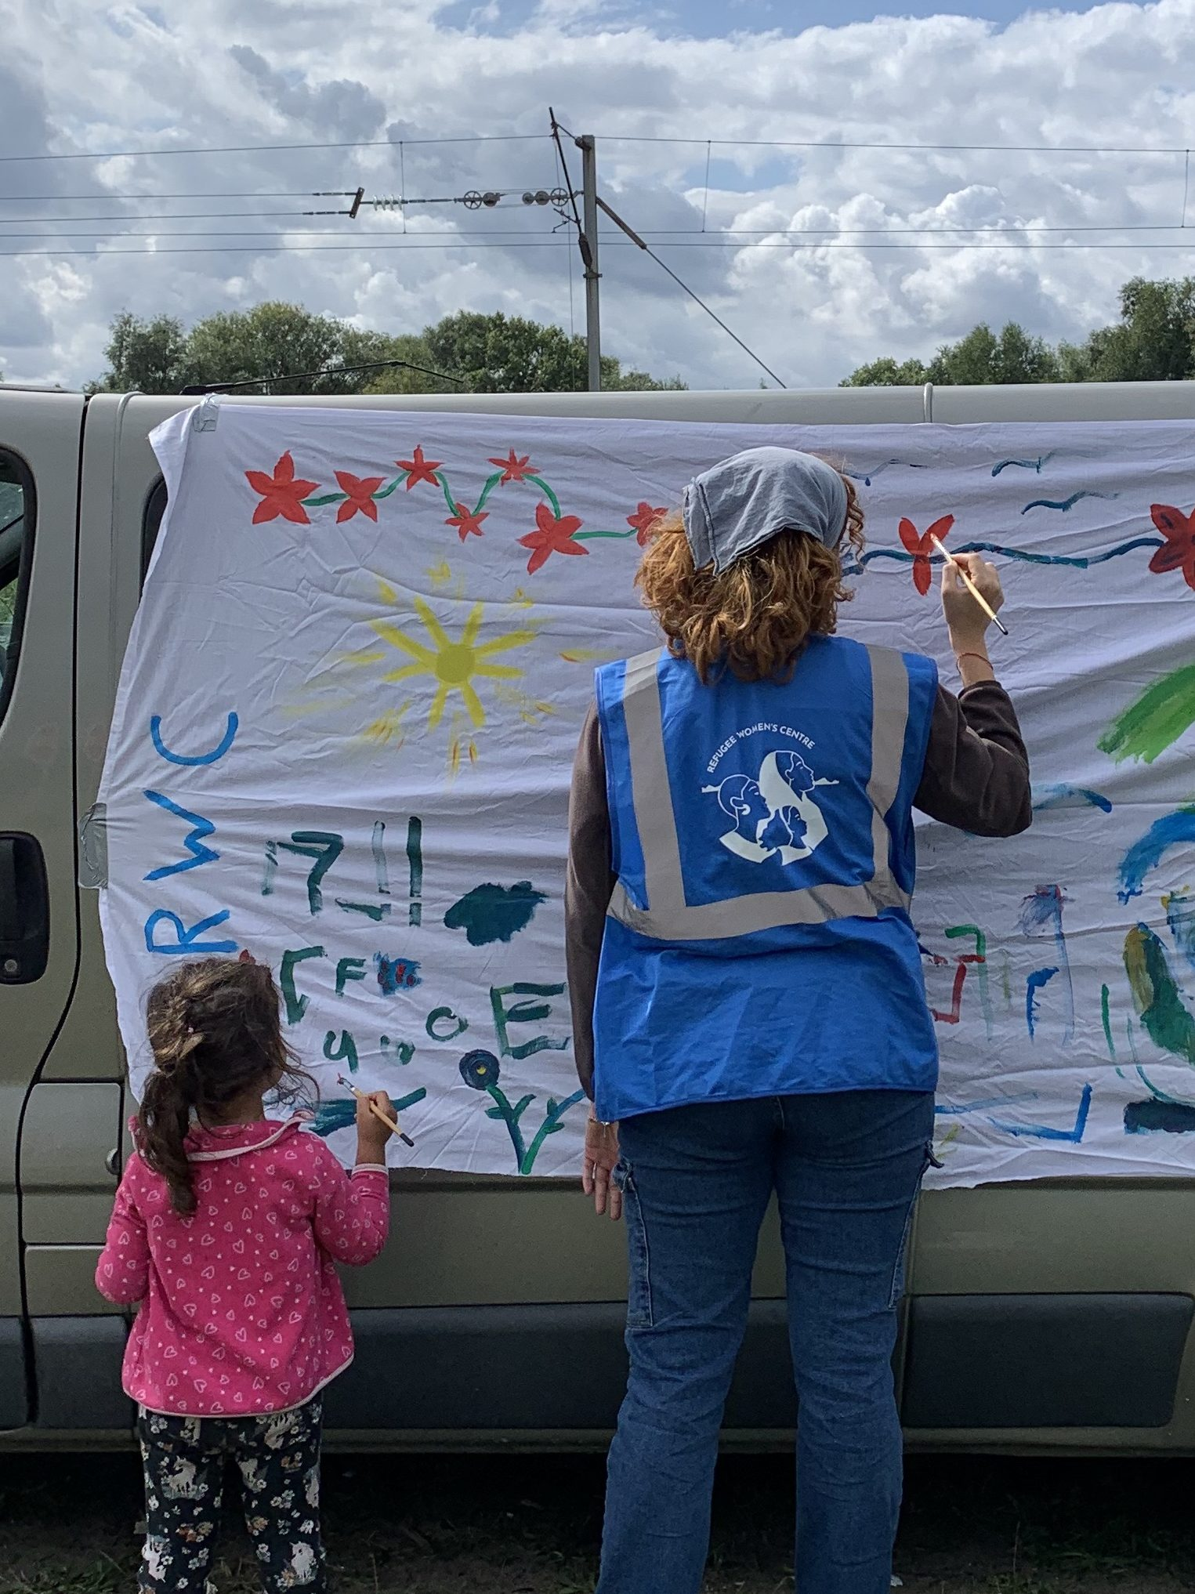
REFUGEE WOMEN’S
CENTRE
3
Calais and Dunkirk
DESCRIPTION OF THE INITIATIVE
An intersectional feminist collective supporting migrant women and families.
A SYSTEMIC APPROACH
A holistic approach addressing material needs (emergency response and basic requirements such as shelter, food and psychosocial support) as well as the need to feel supported and connected to others (creative leisure activities, language exchange sessions, etc.).
Partnerships with various NGOs and local associations, notably Family Planning, Médecins Sans Frontières, the Red Cross, Gynaecology Without Borders, etc., but no support from local authorities.
Credit: Refugee Women’s Centre website

Slide 16
Mapping ‘Agents of Change’
4

Slide 17
4
MAPPING
RESULTS OF THE MAPPING
162 organisations identified across the region, mainly voluntary organisations, of which:
16% in social work
13% working on gender equality issues
11% related to employment and economic growth
7% on environmental issues
7% in educational activities, particularly global citizenship
5% on migration issues

Slide 18

WHAT’S NEXT?
2
WHAT HAPPENS NEXT?
Financial and technical support for at least four citizen-led initiatives spearheaded by young people, girls and women.
Promoting these initiatives across Europe via a web documentary.
More info: SUBLIME SDGs - Lianes coopération
Insert an image

Slide 19



CONTACTS
Virage Énergie contact
Lianes contact
Lise
SARETE
Nadège RICHE
Project Manager, ‘Energy and Climate’
Project Officer, ‘Gender and Human Rights’
lsarete@virage-energie.org
07 75 70 16 48
n.riche@lianescooperation.org
07 84 63 01 49
Study commissioned by Lianes Coopération, carried out by Virage Énergie
Written by: Lise Sarete (Virage Énergie)
Proofread by: Barbara Nicoloso (Virage Énergie); Nadège Riche (Lianes Coopération)

Slide 20
THANK YOU
Have a nice day

